Slide 1
Template
Problem Statement : Web application for a music company to segregate playlists based on different moods (ex. Happy, sad, calm, energetic, etc). Two types of users: Company Representative(Admin) and Business User (End user). Company user can add, modify, classify and delete songs from the system. Business user can search and listen to songs according the mood specified. Business user can give feedback on the mood based autogenerated playlist. The system should automatically change/add new mood type of that song(s) based on feedback.
Problem Statement Number: 14
Team Name : CREEDORIANS
Team Leader Name : Lavanya Singh
College Name: SRMIST

Slide 2
Idea / Approach details
Our basic idea was to make a web application for a music company to segregate playlists based on different moods.

Slide 3
Describe your Technology stack here
We divided the technology stacks of website in three different segments-
Frontend
HTML 5 & CSS 3
SASS
BOOTSTRAP
2. User Interface
React.js
BOOTSTRAP
3. Backend
PHP
MySQL
000webhost

Slide 4
Application
The basic working of our website is to access the playlist according to the current mood of the user.
The user just have to enter their current mood in the search bar and a list of songs will appear.
We also have a menu bar on our website which has different moods listed. We can click on any mood and get a list of songs.
Our application also provides features such as downloading songs and song recommendations.

Slide 5
Day 2 additions
In day two, we made our frontend more precise and attractive according to the suggestion given by our mentors.
We also connected our frontend and UI of the website with the backend using Php and MySql.
We then hosted our website using 000webhost.
Api 1 Link:- https://creedorians.000webhostapp.com/getPlaylist.php

Slide 6
Day 2 Addition(contd.)
Api 1 Link:- https://creedorians.000webhostapp.com/getPlaylist.php
Api 2 Link:- https://creedorians.000webhostapp.com/moodUpdate.php
Website Link:-http://creedorians.000webhostapp.com/build/

Slide 7
Day 3 additions
The team’s journey was descent through out the Hackathon. We also faced some problems which were later solved by our mentors. The problem included selecting a proper User Interface. Meanwhile in the development of our website, the server space got completely occupied because of which we had to pull out some songs out of the playlist.

Slide 8
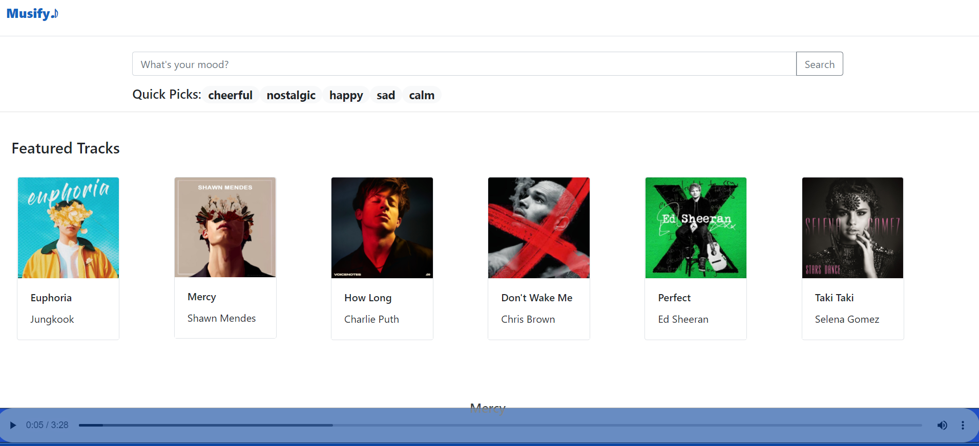
Website preview

Slide 9
